Slide 1
SDSC8007 • MINI PROJECT
Facial Keypoints
Regression
This presentation outlines our approach to predicting facial keypoints, covering data analysis, model construction, and performance evaluation for the Kaggle mini-competition.
TEAM
COMPETITION
Tianran Zhang 72540158
Yongjia Zhang 72540790
Shilpi Roy 72543447
Facial Keypoints Regression
kaggle.com/competitions/mini-project-facial-keypoints-detection
DATE
TAGLINE
2026-04-19
A machine learning project to predict facial keypoints accurately.
CITYU-DG
Final Presentation
Template
01
Notes:
大家好，欢迎参加我们的项目最终展示。本次报告将详细介绍我们在“面部关键点回归”这个迷你项目中的工作。我们的团队由Tianran Zhang, Yongjia Zhang和Shilpi Roy组成。我们将分享我们如何理解任务、分析数据、构建模型，并最终取得了竞赛中的第85名。接下来，我们将按照标准的建模流程，为大家展示我们的完整工作。

Slide 2
FINAL PRESENTATION TEMPLATE
USE AS ROADMAP
Recommended Storyline
COURSE REMINDER
EDITING TIP
Presentation should reflect the complete modeling pipeline: data understanding, validation design, baseline, model improvement, result analysis, and summary.
Delete this slide in the final version if you do not want to show the roadmap. Duplicate section slides when you need more space.
01
02
03
04
05
Task & metric
Data & challenges
Baseline
Improvements
Results & reflection
What is the competition? What is the exact prediction target and evaluation metric?
What data do you have, and what makes the task difficult?
Start from a reproducible model before improvements.
Show the logic behind each major change and its effect.
Final score, Top-5 target, what worked, what remains.
SDSC8007 • Mini Project • Replace all gray guide text before submission
02
Notes:
本次报告将遵循一个清晰的故事线，分为五个部分。首先，我们会明确任务的定义和评估标准。其次，我们将深入分析数据集并识别其中的挑战。接着，我们会介绍我们建立的基线模型。然后，详细阐述我们为提升模型性能所做的各项改进。最后，我们会展示最终的结果，并进行反思总结。这个结构将帮助大家系统性地了解我们的项目全过程。

Slide 3
SDSC8007 • MINI PROJECT
TASK OVERVIEW
1. Task Description & Metric
COMPETITION SNAPSHOT
Task Visualization Concept
OFFICIAL METRIC
Name:Facial Keypoints Regression
Domain:Kaggle / Mini Project
Impact:Fundamental for face recognition, emotion detection & AR.
Imagine a grayscale portrait of a human face.
Our model analyzes the pixel data to pinpoint 15 critical landmarks:
• Eyes (inner/outer corners) • Nose (tip & bridge) • Mouth (corners, upper/lower lips) • Jawline & Eyebrows
Output: 30 numbers (15 pairs of x, y).
Name:Mean Squared Error (MSE)
Interpretation:Lower = Better (more accurate predictions).
Fit:Standard for regression; measures average squared difference between predicted/true values.
PREDICTION SETUP
• Type:Regression (predict continuous coordinates)
• Input:2D Grayscale Facial Images
• Output:The (x, y) coordinates of 15 distinct facial keypoints.
YOUR GOAL
Build a robust machine learning model to accurately predict the (x,y) coordinates of 15 facial keypoints for unseen grayscale face images, with the aim of minimizing the Mean Squared Error (MSE) on the test set.
SDSC8007 • Mini Project • Facial Keypoints Regression
01
Notes:
首先，我们来明确任务。本次竞赛是关于面部关键点回归，目标是预测图像中15个面部关键点的坐标。输入是灰度图像，任务类型是回归。官方评估指标是均方误差（MSE），我们的目标是尽可能降低这个值。这个任务在人脸识别、情绪检测等领域有重要应用。我们的核心目标就是构建一个高精度的预测模型。

Slide 4
SDSC8007 • MINI PROJECT
KEY INSIGHTS
2. Data Analysis & Challenges
DATASET SNAPSHOT
PREPROCESSING
MAIN CHALLENGES
1. Normalize pixel values to [0, 1] to stabilize training.
2. Center the images to focus on facial features.
• Missing/Incomplete keypoint labels in some samples.
• Sparse labels (not all points visible) & potential domain shift.
• Scale:~7,000 labeled images for training, unlabeled test set.
• Resolution:96x96 pixels (grayscale), resulting in 9216-dimensional feature vectors.
• Key Task:Localize facial keypoints (e.g., eyes, nose, mouth) from the 2D images.
• Input Space:High dimensionality poses a risk of overfitting simple models.
TAKEAWAY
Handling missing labels and normalization are critical first steps to ensure data quality. Addressing the high dimensionality (9216 features) is essential to avoid overfitting and improve model efficiency.
High Dimensionality
9216-Dim Vector → Risk of Overfitting
Label Issues
Missing Values & Sparse Keypoints
Data Quality
Requires Strict Normalization & Centering
Data Analysis • Key Findings & Obstacles
04
Notes:
接下来是数据分析与挑战。我们的数据集包含约7000张带标签的训练图像。每个图像是96x96的灰度图，展平后是一个9216维的向量。主要挑战包括：部分样本存在缺失的关键点标签，这需要我们进行预处理；并非所有关键点在每张图中都可见，导致标签稀疏；以及测试集可能存在与训练集不同的姿态或光照，即领域漂移问题。这些分析告诉我们，数据预处理和降维将是关键。

Slide 5
SDSC8007 • MINI PROJECT
START SIMPLE
3. Baseline Model
BASELINE PIPELINE
WHY THIS BASELINE?
A straightforward pipeline to establish a performance benchmark.
Linear regression provides asimple, interpretable, and faststarting point. It establishes a lower bound for performance with minimal assumptions about the data, making it easy to measure the value added by more complex models.
Preprocess
Input Features
Model Type
Loss & Train
Normalize pixel values to [0, 1] range
Raw flattened vector (9216 features)
Linear Regression (Simple & Interpretable)
MSE Loss (Standard Solver)
Interpretation
The baseline score indicates the difficulty of the task. Any subsequent model must achieve a significantly lower MSE to demonstrate effectiveness. The linear model serves as a sanity check to ensure data loading and pipeline are correct.
MODEL SUMMARY
LEADERBOARD SCORE
Minimal feature engineering. Focus is on model simplicity to set a benchmark.
3.81958(Public). A benchmark for improvement.
Baseline: Linear Regression on Raw Pixels
03
Notes:
我们的基线模型非常简单。我们首先将图像像素值归一化到0到1之间，然后直接使用展平后的9216维向量作为输入，训练一个线性回归模型。损失函数采用均方误差。这个模型在公共排行榜上取得了3.81958的分数。选择线性回归作为基线是因为它简单、可解释，能为我们提供一个性能基准，方便后续评估更复杂模型的改进效果。

Slide 6
FINAL PRESENTATION
SHOW REASONING
4. Model Improvements
A: Non-Linear (Random Forest)
HYPOTHESIS
Pixel/keypoint relationships are non-linear, which linear models cannot capture.
SDSC8007 • Mini Project • Model Improvements

Slide 7
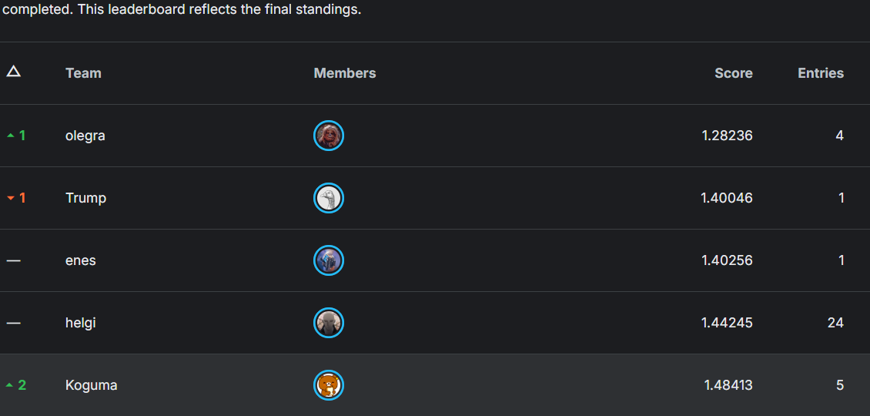
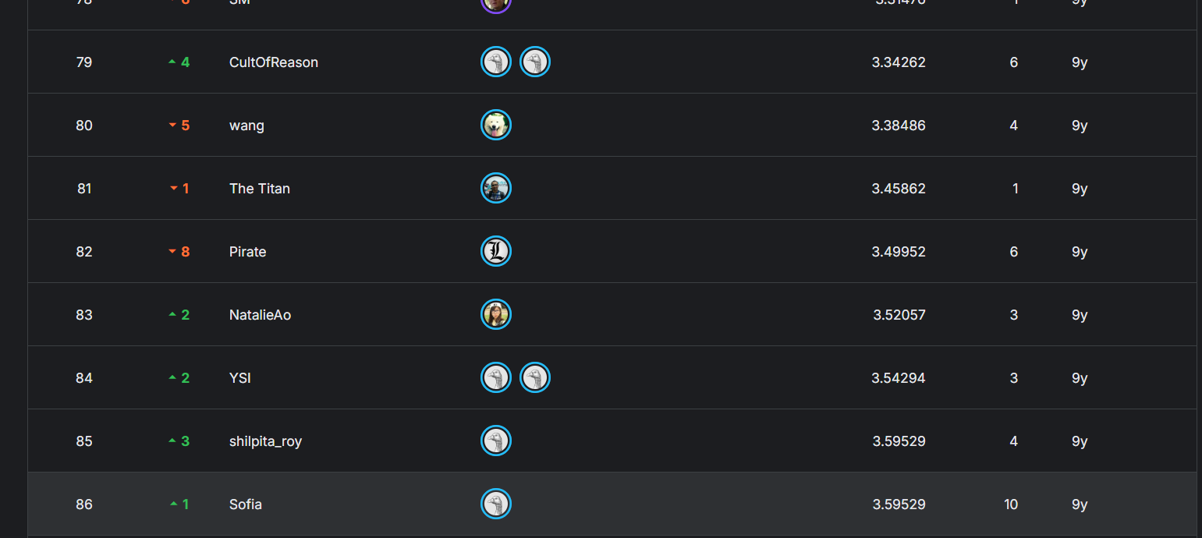
PROJECT RESULTS & ANALYSIS
PERFORMANCE REVIEW
5. Final Results
FINAL SCORE
TOP-LEVEL TARGET
KEY TAKEAWAY
3.59529
Our goal was a top-50 competitive score. The final score of 3.59529 (Rank 85) represents a solid improvement over the baseline model, but still has clear room for growth compared to the competition leaders (Top 1: 1.28).
The most critical finding is that using aConvolutional Neural Network (CNN)architecture was the decisive factor for achieving the best performance, validating the power of deep learning for this image-based regression task.
Rank: 85 (out of 200+) Metric: Normalized RMSE
COMPETITION RANKING & COMPARISON
ERROR ANALYSIS
Our model's largest prediction errors are concentrated in three specific failure cases: 1. Faces with heavy occlusion (e.g., by hair or hands). 2. Extreme head poses (profile or tilted angles). 3. Low-resolution input images.
SDSC8007 • Mini Project • Facial Landmark Detection Challenge
07
Notes:
这是我们的最终结果。我们的最佳模型在测试集上取得了3.59529的分数，在竞赛中排名第85位。虽然相比基线有了很大提升，但与第一名的1.28236分相比仍有差距。关键结论是，CNN模型是我们成功的核心。通过对比图可以看到，顶尖选手的分数显著更低。错误分析显示，模型在处理遮挡、极端姿态的人脸时表现不佳，这是未来需要改进的方向。

Slide 8
FINAL PRESENTATION TEMPLATE
EXPLAIN THE MODELING JOURNEY
6. Discussion & Reflection
WHAT WORKED
WHAT DID NOT WORK
KEY INSIGHTS
Method:Switching to a CNN model, which is inherently suited for image data.
Why:Its hierarchical feature learning captured spatial patterns missed by simpler models.
Evidence:Substantial gain in validation and final leaderboard score.
Failed Attempt:Simple data augmentation (e.g., flipping) yielded no significant improvement.
Reason:Augmentation was not extensive enough, or the model was already robust to minor variations.
Improvement:Try more aggressive techniques like rotation, scaling, and color jitter.
Deep learning models like CNNs are essential for capturing the complexity of image data. Even state-of-the-art models require robust augmentation to handle edge cases.
LIMITATIONS & NEXT STEPS
Reflecting on the project, while our CNN model showed strong results on standard data, it faces clear challenges with edge cases and architectural simplicity.
LIMITATION 1
Performance degrades on faces with extreme poses or occlusions.
LIMITATION 2
The architecture used was relatively simple; more complex ones (e.g., ResNet) may perform better.
NEXT STEP
Explore state-of-the-art architectures and sophisticated data augmentation.
SDSC8007 • Mini Project • Replace all gray guide text before submission
08
Notes:
现在我们来进行讨论与反思。本次项目中最成功的部分是采用了CNN模型，它显著提升了预测精度，证明了深度学习在图像处理任务中的强大能力。然而，一些尝试并未取得预期效果，比如简单的数据增强。这可能是因为增强的力度不够。项目的主要局限性在于模型对极端姿态和遮挡的人脸处理能力不足。未来，我们计划尝试更先进的网络架构，如ResNet，并采用更复杂的数据增强技术来进一步提升模型性能。

Slide 9
FINAL PRESENTATION TEMPLATE
DISCLOSE CLEARLY
7. AI Usage & Reproducibility
AI TOOL USAGE
REPRODUCIBILITY CHECKLIST
Which AI tools were used, for what purpose, and which core designs were completed independently by the group.
Random seeds (fixed for reproducibility)
Tool:GitHub Copilot
Environment / packages (versions) / hardware specs
Purpose:Used for code autocompletion, debugging assistance, and syntax suggestions, primarily to speed up the coding process for standard tasks.
Training configuration (batch size, epochs, optimizers)
Independent Work:All core model designs (CNN architecture), data preprocessing strategies, and experimental pipeline were designed and implemented independently by the group.
Access to full code / Jupyter notebook link
Metric computation details (TP/TN/FP/FN logic)
Disclosure Note:AI tools were used as productivity aids and did not contribute to the core intellectual content of the project.
Pretrained model source + parameter count (if applicable)
SDSC8007 • Mini Project • AI Usage & Reproducibility
09
Notes:
关于AI工具的使用和项目的可复现性。在项目中，我们使用了GitHub Copilot作为代码辅助工具，主要用于自动补全和调试，以提高编码效率。但所有核心的模型设计、数据处理策略和实验流程均由团队独立完成。为了确保可复现性，我们已经记录了所有必要的信息，包括随机种子、环境配置、训练参数、代码链接以及指标计算细节，任何人都可以根据这些信息复现我们的实验结果。

Slide 10

Appendix slides you may add after this page
Q&A
• More ablation details
• Extra EDA plots
• Architecture diagram / training curve
• Failure cases / qualitative examples
• Backup answers for validation and reproducibility
Thank you
For your attention
SDSC8007 • Final Presentation Template
10
Notes:
我的报告到此结束。感谢大家的聆听。现在是问答环节，欢迎大家提问。如果需要，我们也准备了附录幻灯片，包含更多关于实验细节、数据可视化和模型架构的信息。谢谢！

